Slide 1
The Effect Of Hurricanes on surface water Salinity Levels
Christopher Andalia, Joseph Hallack, and William Thomas

Slide 2
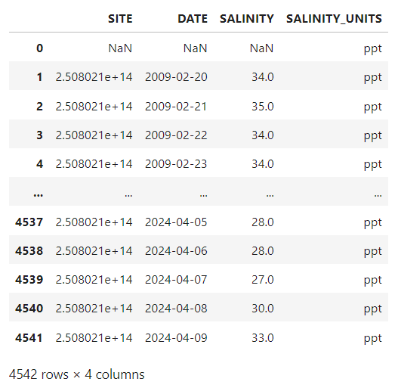
Python: cleaning data:
Raw data
Cleaning data:
1. slice and dice through dates (focusing on Hurricanes Ian and Nicole in 2022)
2. Cut NaN values and site ID
3. Index to date-time

Slide 3
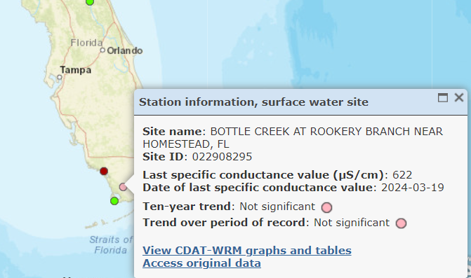
Python visualizing relationships:
Hypothesis: Hurricanes would cause only an increase in surface water salinity
Discovered much more dynamic relationship between Hurricanes and surface water salinity
Hurricanes cause a rise and fall of salinity levels due to freshwater rain and salty storm surge
Data was taken from U.S. Geological survey (USGS)
Sample Site Location

Slide 4
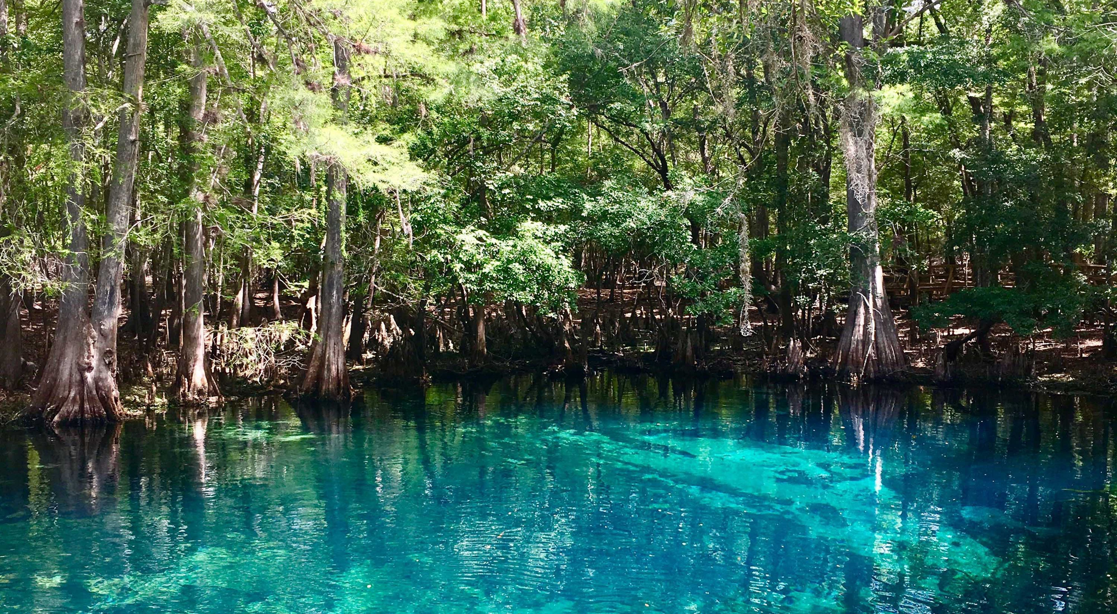
Why Should we care?
Ecosystem Health
Water Quality
Agriculture
Infrastructure
https://www.nature.org/en-us/about-us/where-we-work/united-states/florida/stories-in-florida/florida-fresh-water/

Slide 5
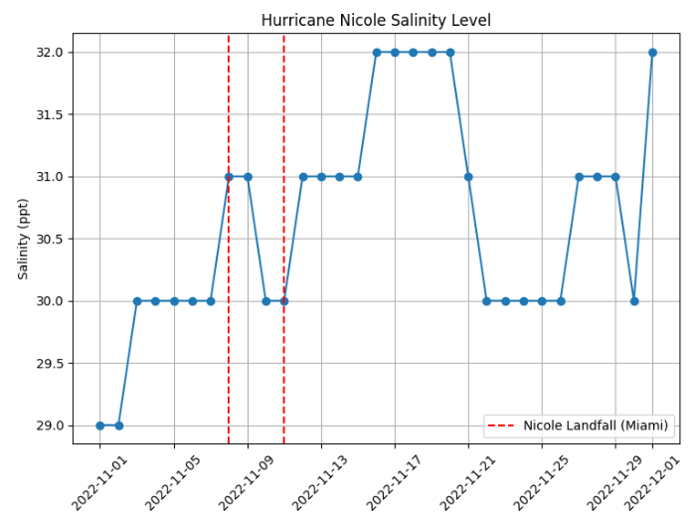
Data: Nicole
Decrease in Salinity at Landfall due to heavy rainfall before the storm surge hits
Indicating that hurricanes can cause a decrease in surface water salinity, in coastal areas due to heavy rainfall.

Slide 6
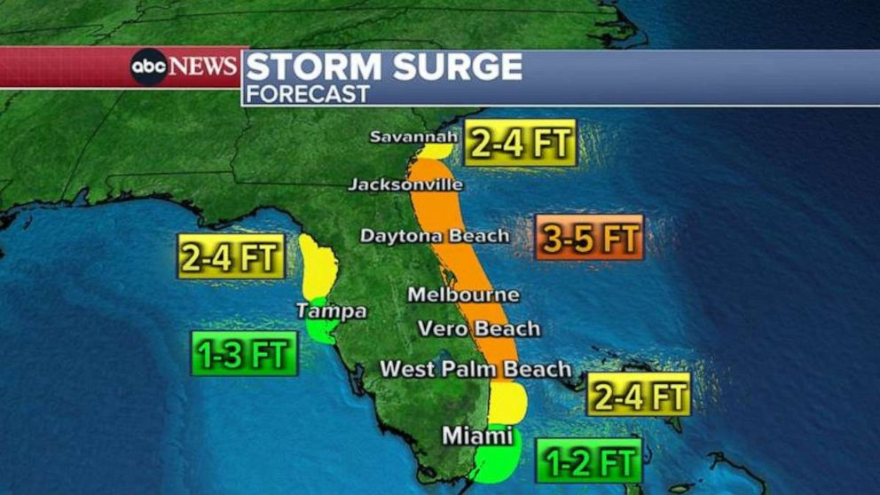
Hurricane Nicole Data: What does this tell us?
Lag Time and Salinity Rise:
Approximately two days after Nicole made landfall, there was a rise in salinity
The salinity peaked at 32.0 ppt.
This rise in salinity suggests a correlation with the settling of the salty storm surge into the sample site.
The lag time between the hurricane event and the rise in salinity underscores the time required for the effects of the storm surge to propagate and influence the surface water salinity levels.
https://abcnews.go.com/US/subtropical-storm-nicole-hurricane-nears-florida/story?id=92789211

Slide 7
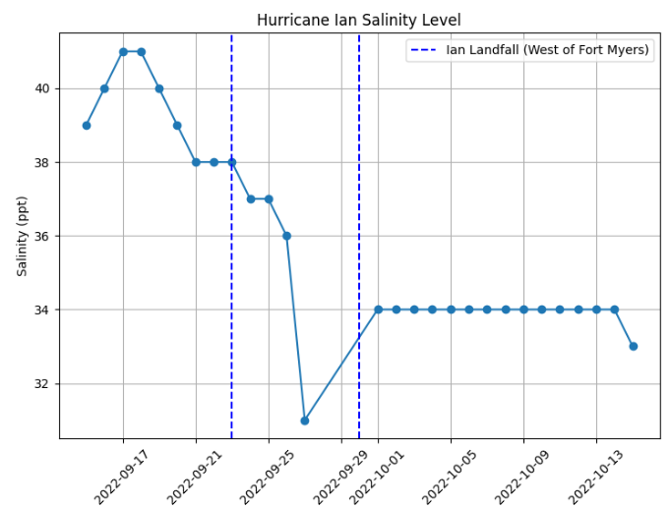
Data: Ian
Ian made landfall in the Southwest Florida area. Which shows why the spike in salinity is before landfall
During landfall, there was a decrease in salinity levels.
This decrease in salinity suggests the influence of the hurricane on surface water conditions, likely due to factors heavy rainfall on the outer bands of Ian.

Slide 8
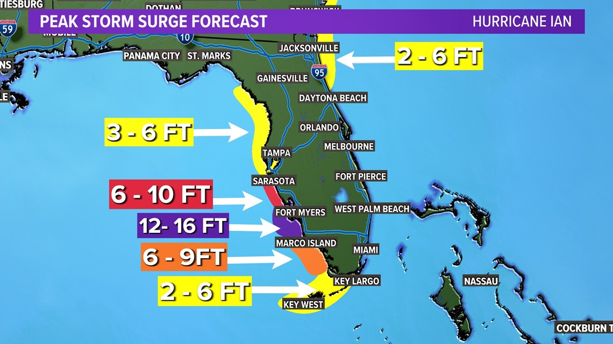
Hurricane Ian Data: What does this tell us?
Prior to Hurricane Ian's landfall, Ian’s storm surge hit our sample site.
The graph shows a spike in salinity corresponding to this storm surge event.
The timing of the spike in salinity aligns with the period before Hurricane Ian's landfall, and makes sense due to where Ian hit.
https://www.wfaa.com/article/weather/hurricane-ian-tracker-strength-landfall-map-storm-surge-rain-wind-map/287-f9f38798-d537-432c-b587-63b8caea2d96

Slide 9

Any Questions?
https://www.scienceofpeople.com/21-questions-game/

Slide 10
Bibliography:
Cañedo-Argüelles, M., Kefford, B. J., Piscart, C., Prat, N., Schäfer, R. B., & Schulz, C. J. (2013). Salinisation of rivers: an urgent ecological issue. Environmental pollution, 173, 157-167.
Herbert, E. R., Boon, P., Burgin, A. J., Neubauer, S. C., Franklin, R. B., Ardón, M., ... & Gell, P. (2015). A global perspective on wetland salinization: ecological consequences of a growing threat to freshwater wetlands. Ecosphere, 6(10), 1-43.
Jolly, I. D., McEwan, K. L., & Holland, K. L. (2008). A review of groundwater–surface water interactions in arid/semi-arid wetlands and the consequences of salinity for wetland ecology. Ecohydrology: Ecosystems, Land and Water Process Interactions, Ecohydrogeomorphology, 1(1), 43-58.
Machado, R. M. A., & Serralheiro, R. P. (2017). Soil salinity: effect on vegetable crop growth. Management practices to prevent and mitigate soil salinization. Horticulturae, 3(2), 30.
Werner, A. D., Bakker, M., Post, V. E., Vandenbohede, A., Lu, C., Ataie-Ashtiani, B., ... & Barry, D. A. (2013). Seawater intrusion processes, investigation and management: recent advances and future challenges. Advances in water resources, 51, 3-26.
Babaei, A. A., Ghassemi, H., & Dehghanian, A. (2014). Effects of salinity on corrosion behavior of 316L stainless steel in petrochemical industries. Journal of Solid State Electrochemistry, 18(8), 2043-2048.
Talukder, M. R. R., Rutherford, S., Huang, C., Phung, D., Islam, M. Z., & Chu, C. (2017). Drinking water salinity and risk of hypertension: A systematic review and meta-analysis. Archives of environmental & occupational health, 72(3), 126-138.
U.S. Geological Survey. (2024). Surface Water Salinity Data. Retrieved from https://fl.water.usgs.gov/mapper/site_info.php?site=250802081035500&agency=USGS&info=sal

